Slide 1
Volunteering at Homework House
2022-2023

Slide 2
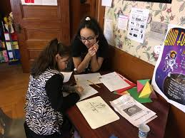
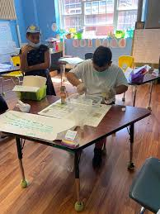
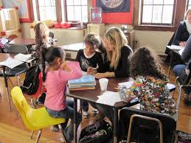
Day In the Life of a Volunteer

Slide 3
Upon Arrival:
Arrive at scheduled location
Both in Holyoke
Arrival time is around 3:30PM
According to classroom placement & your availability
Clock in on the “InItLive” app (separate email will be sent w/ instructions to sign up for app)
You will clock in and out for each day you volunteer
Head to your assigned classroom
I will be there on everyone's first day for a building tour, helping with the app, ect

Slide 4
In the classroom:
Greet the Site Supervisor
Site Supervisor = teacher in the classroom
Site Supervisor will inform you on:
What is planned for the afternoon
Assigned reading/writing, math, projects, ect.
Which student(s) you will be working with that day
You will likely work with the same few students each time you volunteer
Once the students arrive, they will first have a snack, then they will begin their homework then work on assigned work for the afternoon.
Many students are working below their grade levels
Always encourage them to keep trying, and to work hard!
If the student has no homework, begin helping with other assigned work for that day
Fill out daily Progress Reports!

Slide 5
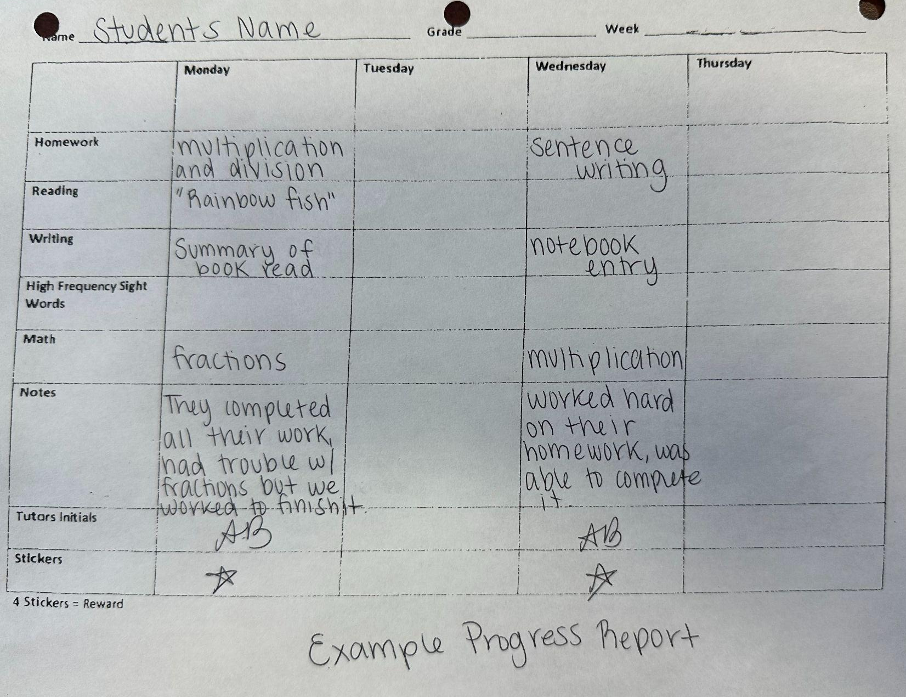
Example Progress Report
These will be filled out each time you volunteer, for each student you work with on that day.
Small descriptions of the work they did that day
Short note of how the student did with their work

Slide 6
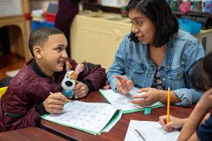
After Homework & Assigned Work:
Free time!
Board games
Arts and Crafts
Class Project
Science projects, holiday projects, ect
Playing in the gym
Great time to connect with the students
Ask them questions about things they enjoy
Ask them about school
What they enjoy doing on the weekends
Connecting with the students is very important!
Students look up to volunteers
Be a positive role model
Students love the volunteers, and look forward to working with them each week!

Slide 7
At the end of your shift:
End of shift is between 5:30PM and 5:45PM
Check out with your Site Supervisor
Let them know how your day went
Clock out on the “InItLive” app
You’ve completed your volunteering shift for the day! :)
Few Extra Things:
You will be in the same classroom every time you Volunteer
The routine stays the same each time you volunteer
If you forget to clock in or out, email me to correct your times
Any issues with volunteering, or something in the classroom do not hesitate to contact me, or speak to your Site Supervisor
We want you to have a great volunteering experience with us!
Dress appropriately
Everyone in a mandated reporter
If you have concerns about a student, inform me and your Site Supervisor

Slide 8
Homework House Website: homeworkhouseholyoke.org
Under the “Volunteer” tab, click
“Volunteer Application”

